Slide 1
Basic xtUML Modeling

Slide 2
Levels of Commitment
Natural language and informal diagrams
Use cases
Activity diagrams
Sequence diagrams
Structural models
Components & Interfaces
Class models
Data types
Behavioral models
State models
Activities
}
Prior course

Slide 3
Requirements Clarification Process
The process was:
Find all your people, resources, practices, etc.
Find out what the system-as-a-whole does
Determine the precise behavior of each use case
And establish how it communicates with others
But it was really all about learning about the problem.
Get Organized
Use Cases
Activity Diagrams
Sequence Diagrams

Slide 4
Abstraction
Now that everything is:
reviewed,
signed off, and
it’s all in our heads,
it is time to
THINK
And from that thinking, we create, and commit to, abstractions.

Slide 5
Levels of Commitment
We represent our abstractions in models of various types.
Natural language and informal diagrams
Use cases
Activity diagrams
Sequence diagrams
Structural models
Components & Interfaces
Class models
Data types
Behavioral models
State models
Activities
}
This course

Slide 6
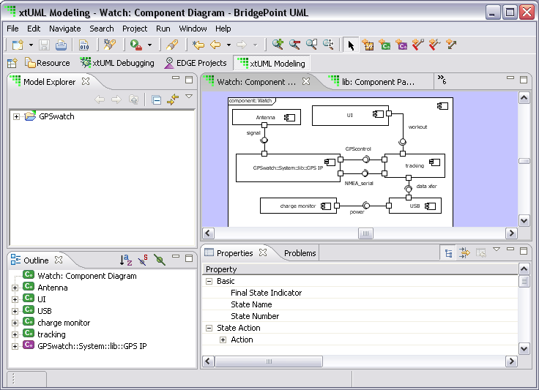
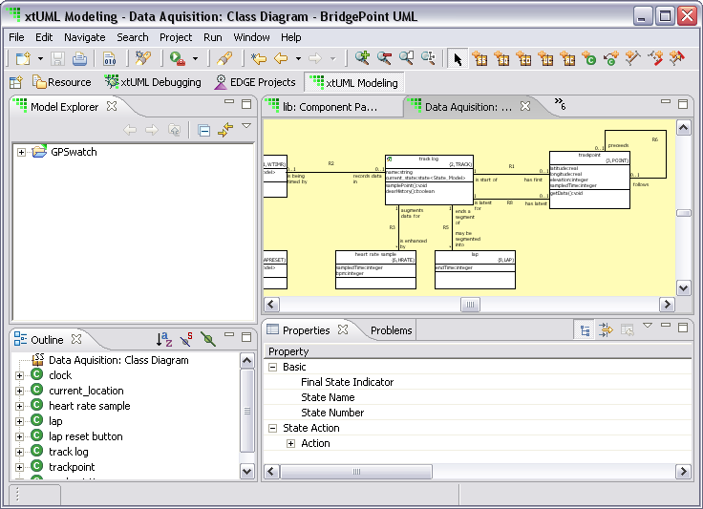
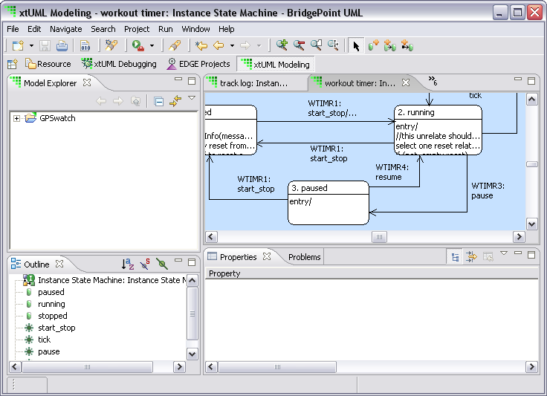
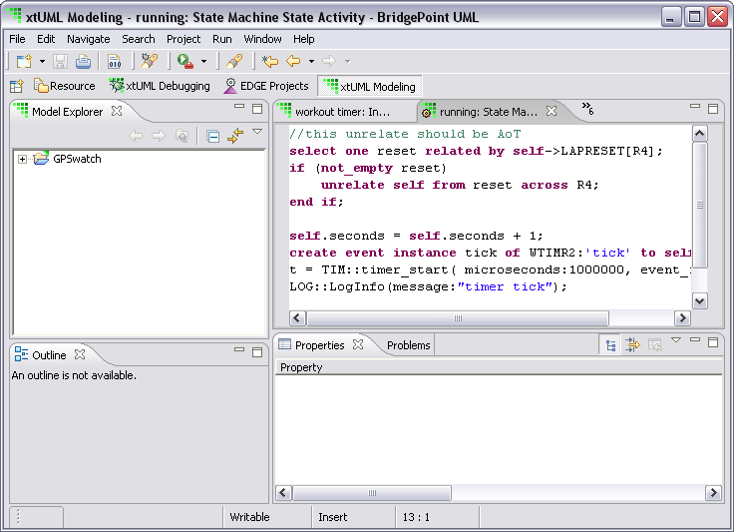
Executable Model Hierarchy
High level
Component Diagram
Decompose the application
Define Interfaces
Class Diagram
Abstractions
Operations
State Diagram
Lifecycle
Event handling
Activities
Processing
Low level

Slide 7
Table of Contents
Requirements Clarification
Classes
Attributes
Associations
Class Modeling
State Models
Activities
Actions
Distribution of Intelligence
Model Execution
Components and Interfaces
Model-based Testing
What’s Next?
Class Diagram
Abstractions
Operations
State Diagram
Lifecycle
Event handling
Activities
Processing
Component Diagram
Decompose the application
Define Interfaces
Notes:
Mention that some sections may be covered out of order.

Slide 8
1. Requirements Clarification
1

Slide 9
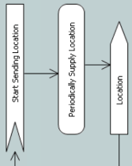

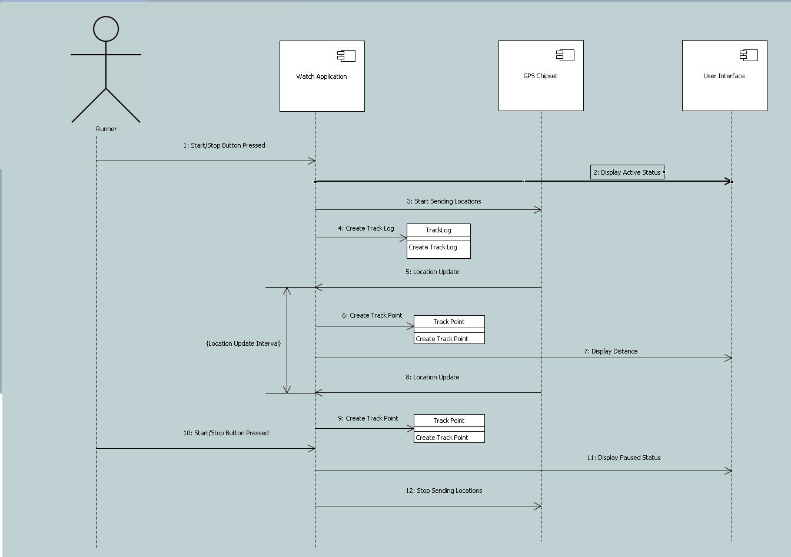

Building Executable Models
To begin to build executable models, you must first load the requirements clarification models and functional specification into your brain.
Use
Case
Use
Case
Functional
Specification

Slide 10


Functional Specification?
Wait, what?
Functional specification?
I thought we didn’t need one of those with this method!
Modeling without a Specification
Unbounded problem space
Model a little bit of everything
Model nothing completely
An xtUML model is a solution…
…that satisfies a set of requirements.
It is not a requirements specification

Slide 11
Functional Specification
A good specification contains:
Functional requirements indicating what the system does
Each requirement is: identified, unique, cohesive, testable
Use cases illustrating the intended operation of the system
So, I guess we need to build one of those.
Functional
Specification

Slide 12
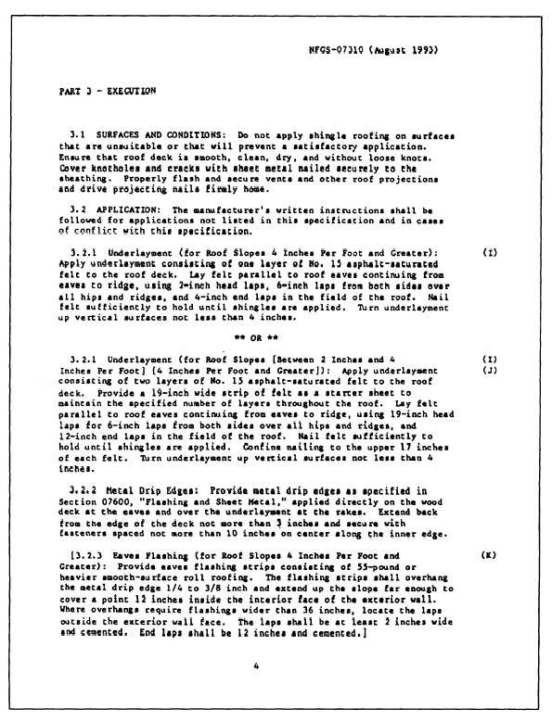
Relationship to Use Cases
Use cases, our basic unit of organization, cover multiple functional requirements.
15
1
16
11
12
41
Functional
Specification
31
Notes:
http://www.q-lab.com/resources/standards/

Slide 13
Each Use Case is a Feature
✔
Features Functions
Request
Elevator
Initiate
Close Door
Request
Elevator
Stop Elevator
Choose Floor
Initiate
Open Door
Doors Open
Move
Elevator

Slide 14

Use Cases
Each use case shall contain:
a description, and optionally,
an activity diagram
a sequence diagram
Use Case Name/Number
Pre-conditions:
Post-conditions:
Scenario:

Slide 15
Use Case Definition
Each use case follows this pattern:
These are in natural language.
Read them.
<Use Case Number>: <Use Case Name>
Pre-conditions: What must be true before the use case can execute
Post-conditions: What must be true after the use case has executed
Scenario: A description of just what happens

Slide 16
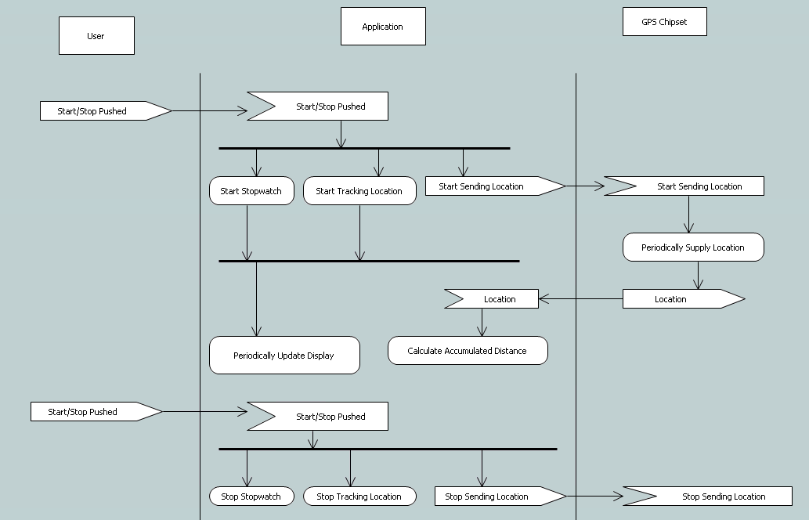
Activity Diagram
Synchronization Fork
Actor role
Event received
Signal Send
Synchronization Join
Activity
Swimlane

Slide 17
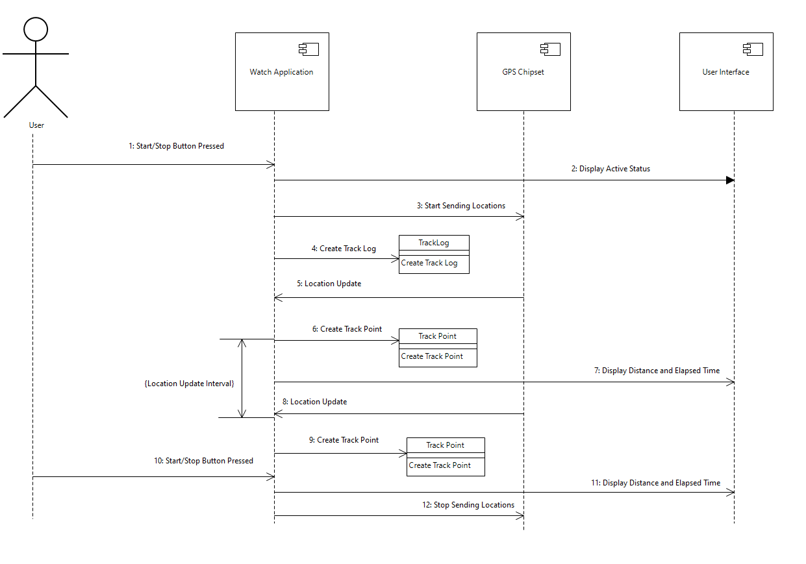
Sequence Diagrams
Build a sequence diagram if it helps detail your understanding.
Lifeline
Mark
Synchronous message
Span
Asynchronous message

Slide 18
2. Classes
2

Slide 19
Executable Model Hierarchy
High level
Component Diagram
Decompose the application
Define Interfaces
Class Diagram
Abstractions
Operations
Low level

Slide 20
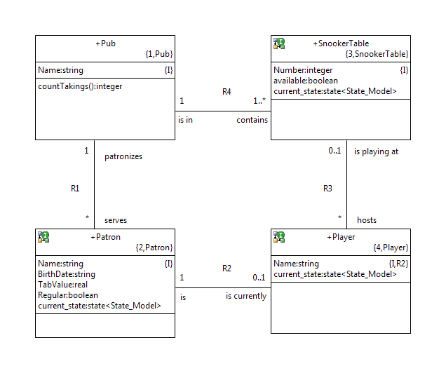
Class Diagram
A class diagram consists of:
classes
attributes
associations, and
operations
We shall examine each in turn.

Slide 21
Class
A class is a conceptual entity within the subject matter at hand.
conceptual |kənˈsep ch oōəl|
adjective
of, relating to, or based on mental concepts
entity |ˈentitē|
noun ( pl. -ties)
a thing with distinct and independent existence
subject matter |ˈsəbjəkt ˈmatər|
topic under consideration

Slide 22
Class
A class represents a set of instances that all:
have the same behavior
are described in the same way
“Set” means that each instance is unique.
“Same behavior” means that each instance behaves in the same way as the other instances.
“Described in the same way” means that any data describing the instance applies uniformly to each one.

Slide 23

Start with the Requirements!
Re-read the requirements, as clarified.
Use Case Name/Number
Pre-conditions:
Post-conditions:
Scenario:

Slide 24
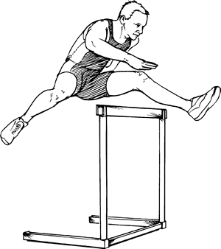

Abstraction Blitz
A blitz is a technique for getting started.
There are no wrong answers.
We don’t categorize
We don’t organize
We don’t evaluate
We just enumerate
The purpose is to provide a starting point.
Notes:
http://www.learnersdictionary.com/definition/hurdle
http://www.officialpsds.com/Blank-Notebook-Paper-PSD70135.html

Slide 25
Finding Classes
Tangible
Intangible
Role
Incident
Interaction
Specification
Don’t classify classes.
These are just guides for places to look.
Notes:
The Intangible category includes conceptual classes; things which represnt entities that are in the real world, but which cannot be touched, e.g. ”Account’.

Slide 26
Tangible Classes
airplane | message
valve | robot
circuit breaker | power supply
dog | dog owner
elevator | cabin
Airplane
Shaft
Runway
Door
Buttons
Cabin
Elevator
Airport

Slide 27
Roles as Classes
broker | client
landlord | tenant
customer | account holder
passenger | administrator
pilot | air traffic controller

Slide 28
Incident Classes
performance | visit
system crash | event
breakdown | service call
request | order
flight | landing

Slide 29
Interaction Classes
cable | pipe connection
birth | link
purchase | marriage
order | sale
command | landing
Licence

Slide 30



Specification Classes
policy type | goal specification
protocol | configuration definition
phone spec. | account type
product spec. | vehicle model
qualification | aircraft type

Slide 31
Finding Classes
This is called “extension.”
We may observe that a number of instances in the subject matter have similar behavior and data.
We abstract from observed instances.

Slide 32
Finding Classes
Or we may observe, identify or define a concept with specific qualification criteria.
We abstract based on our ideal.
This is called “intension.”
THE FOLLOWING ARE THE QUALIFICATIONS A DOG MUST HAVE FOR ENTRY AT CRUFTS

Slide 33

Abstraction Blitz - Process
Remember, we are not categorizing or evaluating
We are simply enumerating
And, we are looking for all abstractions, not just classes
Individually, or as a team…
Enumerate, in writing, all abstractions that come to mind
When you run out of ideas, re-read the requirements
Looking for key things and concepts
When nothing else comes to mind…
Take a break before proceeding with the next step

Slide 34

Abstraction Blitz - Process
Organize your list into the following categories:
Classes
Attributes
Associations
Operations
States
Events
Unsure
Discarded
Notice the last category
Do not delete anything – just move it to the Discarded list
After sorting the list, take another break

Slide 35
Workshop
Blitz at least half-a-dozen classes.
Use the clarified requirements for input.
Be prepared to present your list to the class.

Slide 36
Class Descriptions
Write a class description that explains the basis for abstraction for each class.
Aircraft
Aircraft
Connect the model abstraction to the subject-matter thing.

Slide 37
Class Descriptions
Examples…
Aircraft
Message
Definitions may incorporate inclusion or exclusion criteria.
Anything that flies that must be monitored by the air traffic control system. It may carry anything: passengers, freight, nothing. The rules for what constitutes something that must be monitored are described in ….
A single coherent piece of information sent between two applications. It consists of a header describing the sender and receiver, and a body that can be anything.

Slide 38

Class Descriptions
A good class description:
connects the subject-matter concept to the model abstraction
when appropriate, indicates creation, deletion and lifespan, within the context of the subject matter
can immediately be understood by non-experts, enabling a reader to answer many of her own questions
does not repeat information available elsewhere in the model (e.g., “is related to <otherClass> across R4”)

Slide 39

Class Names
First one may not be the best
It’s called a blitz for a reason
Balancing meaning and verbosity
Tooling makes length (nearly) irrelevant
Certainly, keystrokes should not be driving factor in a name
Struggling to find a good name?
Write the description first
Then, distill the name from the description

Slide 40
Workshop
Write several class descriptions from the classes you identified earlier.

Slide 41
Testing Classes
There are several tests you can apply to classes.
The Uniformity Test
The OR test
The More-than-a-list test
The Table test
The –er test

Slide 42
The Uniformity Test
If instances of your classes have different data or different behavior, you probably have two classes.

Slide 43
The Or Test
If your class description contains ‘or’ in a disjunctive way, you probably have two classes.
An airplane is an aircraft with a minimum take-off speed, or a helicopter.
An airplane is a passenger or cargo aircraft.
An airplane is any member of the commercial or general aviation fleet.

Slide 44
The More-Than-a-List Test
If your class description contains just a list, without any abstraction, you need to search for the basis of abstraction.
A commercial airline is Laos Airways or LAN Ecuador.
A regional airline is an airline that takes short trips, such as Laos Airways or LAN Ecuador.
A regional commercial airline is an airline that takes paying passengers for trips under 500km.

Slide 45
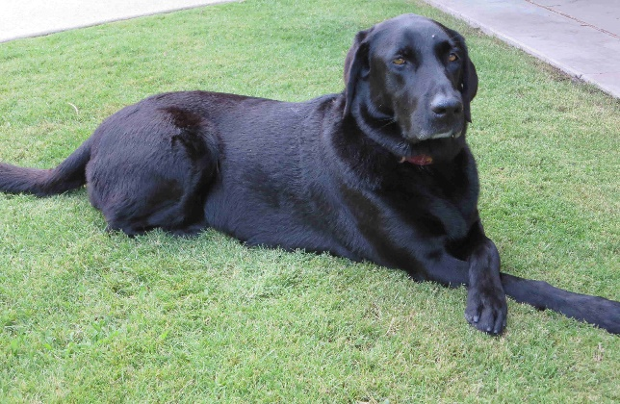

The Table Test
You should be able to fill in a table with candidate instances.
Pets
Name | Breed | Color | Vaccination Due | Most Recent Shedding
Ella | Labrador Retriever | Black | 20-Jun-2022
Tameko | Himalayan | Lilac Point | 18-Aug-2021
Lestat | Ball Python | Black/Brown |  | 07-May-2020
Pinenut | Desert Box Turtle | Brown

Slide 46
The –er Test
Classes should represent real “things” (concepts, rules, specifications, occurrences, incidents) in the physical, hypothetical or abstract world.
They should not be:
implementation oriented
vague –er names
These “classes” tend to be functionality wrappers.
Handler
Controller
Manager

Slide 47
Workshop
Test the classes you have defined up to this point.
Be prepared to share your results with the class, including the class candidates you discarded after testing.

Slide 48
3. Attributes
3

Slide 49
Attributes
An attribute is an abstraction of a single, relevant characteristic that every instance of the class must have.
Each instance of the class may have a different value for the attribute.
“Relevant” depends on the requirements placed on the subject matter.
Aircraft.color may be relevant to fitting out, but not to air traffic control.
Flight
Booking | Start | End | Number | Price
HPFGYI | UIO | MIA | XL516 | $1095
JKLOIP | SYD | SIN | QF5 | $814
HPFGYI | BKK | LPQ | QV633 | $631
GHJKLP | EZE | IGR | AR1724 | $244

Slide 50
Roles of Attributes
Attributes may take on one or more roles. They may be:
descriptive: describes an instance of a class
latitude
color
breed
naming: names an instance of a class
serial number
location
referential: refers to an instance of another class
myOwner
An attribute may take on more than one role. For example, a descriptive naming attribute, location, with values like “north” and “Lane 2”.

Slide 51
Descriptive Attributes
A descriptive attribute provides some information about an instance.
The attribute must be able to have a value at some point in the instance’s lifecycle.
If the attribute value for an instance is “not applicable” you need to factor your class.
If it doesn’t have a value yet, that’s OK.

Slide 52
Naming Attributes
A naming attribute provides a label for an instance.
License Number
Location
Name
The label may also be descriptive.
EntryStand.Location (e.g., values of “North”, “South”)
provides a descriptive name for an instance
The label may be arbitrary.
Employee.EmployeeNumber
Reservation.ConfirmationNumber

Slide 53
Identifiers
An identifier is one or more attributes that, taken together uniquely identify an instance of a class.
It may comprise one or more attributes.
A class may have more than one identifier.
Each attribute that makes up an identifier is an “identifying attribute.”

Slide 54
Referential Attributes
A referential attribute is an attribute that refers to an identifying attribute of another class.
A referential attribute “formalizes an association.”

Slide 55
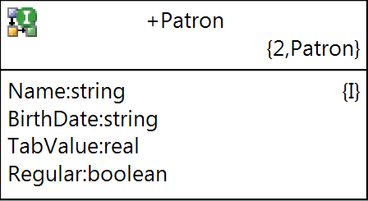
Finding Descriptive Attributes
The terms you defined during requirements clarification are good candidates.

Slide 56

Finding Naming Attributes
Don’t just slap down “ID”!
Ask if there’s anything that properly represents the abstraction.
What identifies a phone?
Notes:
43. Add a line pointing out that IMEI, ICCID, and phone number are three ways to identify a phone, and that all three fall into the natural identifying attribute category. We could also have an interesting discussion about the fact that a SIM is a separate class from the phone, the association between the two classes, a referential attribute that also happens to be an identifier for the referring class, and what happens when a phone is associated with a SIM. This is probably good fodder for an example, and it might make sense to put one into the slides right here.

Slide 57
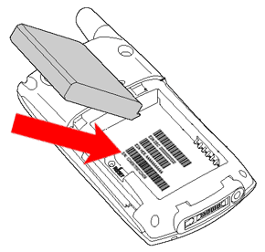

Finding Identifiers
Pick the identifier that captures the abstraction you intend.

Slide 58
Data Types
Every attribute has a domain-specific data type.
It has a value in the context of the subject matter.
Aircraft.Altitude: real
Aircraft.Altitude: height
Body.Length: integer
Body.Length: number of bytes

Slide 59
Workshop
For the classes for which you previously wrote descriptions, list the attributes, including the type of each.
Be prepared to share your attributes with the class, including any you eventually discarded.

Slide 60
Attribute Descriptions
Write an attribute description that explains the basis for abstraction for the attribute.
Altitude
Above Ground
Level (AGL)
Altitude
Mean Sea
Level (MSL)

Slide 61
Examples
Airspeed
Airspeed
Altitude
The speed of the aircraft is how fast it’s going.
The current speed of the aircraft relative to the air through which it travels.
Units: knots
The current altitude (height) of the aircraft.
Units: feet
Origin: Mean Sea Level (MSL)

Slide 62
Examples
Length
Length
Lovely. It also excludes artichokes.
The length of the message excludes the header.
The length of the message payload.
Units: bytes
Range: 0 to 256K-1.
PayloadLength might be a better name?

Slide 63
Attribute Description Guidelines
Connect subject matter concept or quantity to abstraction
Readily understood by subject-matter experts
For quantitative attributes:
Units (meters, yards, degrees Centigrade, milliparsecs)
Origin (above ground level, mean sea level)
Range (-50 – 328; 0-100)
Do we really need to write attribute descriptions? It seems like a good name is enough!
“As a result, JPL engineers mistook acceleration readings measured in English units of pound-seconds for a metric measure of force called newton-seconds.”
(1999 loss of Mars Climate Orbiter)

Slide 64
Testing Attributes
There are several tests you can apply to attributes.
The Applies-to-All-Instances Test
The Valid-Value Test
The Multiple-Value Test
They are all based on an attribute having a single potential value that has meaning in the subject matter.

Slide 65
Applies-to-All-Instances Test
Check that each attribute applies to all instances.
Aircraft Specification
Model | Weight | Range | Runway | Speed
A380 | 276.8 | 15.7 | Group V | 900
B747 | 178.8 | 13.45 | Group IV | 830
Sikorsky H19 | 0.4795 | 0.652 | N/A | 163
Dash 8 | 14.7 | 1.889 | Group II | 500
Notes:
Empty operating weight in megagrams. range in megameters, speed in kmh

Slide 66
Valid-Value Test
Check that each attribute has a valid value at some point in its lifecycle.
Flight
Number | Start | End | Price | Paid
XL1541 | UIO | CUE | $44 | $44
QF5 | SYD | SIN | $814 | $82
My 10th | GLO | GLO | N/A | £150
XL516 | UIO | MIA | $1095

Slide 67
Multiple-Value Test
Check that each attribute has a single value.
Flight
Booking | Start | End | Number | Price
HPFGYI | UIO | MIA | XL516 | $1095
JKLOIP | SYD | SIN | QF5 | $814
HPFGYI | BKK | LPQ | QV634/633 | $631
GHJKLP | EZE | IGR | AR1724 | $244

Slide 68
Workshop
Write attribute descriptions for the attributes you identified earlier.
Apply the tests.
Be prepared to share your descriptions with the class. Highlight attributes that were discarded or changed.

Slide 69
Workshop
Compare your classes, attributes, and descriptions to those in the provided solution.
List issues that require discussion.

Slide 70
4. Associations
4

Slide 71
Binary Associations
A binary association is an abstraction of a relationship between two things that were abstracted as classes.
In other words, a binary association represents a relationship between instances of two classes.
A link is an instance of an association.
links

Slide 72
Binary Associations
Each ‘end’ of the binary association has a:
name that captures the meaning of the association
multiplicity that captures the number of instances that participate
conditionality that captures whether the instances must participate in the association

Slide 73
Names
The name captures the role the “target” class plays with respect to the other end.
These are written:
Many books use roles instead of verb phrases.
Ignore them.
Roles won’t tell you what you need to know.
Dog
owns
Dog Owner
is owned by

Slide 74
Multiplicity
The multiplicity captures the number of instances that participate in the association.
Station
manages
1
Station Manager
1
is managed by
Station
Station Manager

Slide 75
Multiplicity
The multiplicity captures the number of instances that participate in the association.
Dog
owns
1
Dog Owner
1..*
is owned by
Dog
Dog Owner

Slide 76
Conditionality
The conditionality captures whether an instance is required to participate in the association.
Station
is managing
1
Station Manager
0..1
is managed by
Station
Station Manager

Slide 77
Conditionality
The conditionality captures whether an instance is required to participate in the association.
Dog
owns
1
Person
*
is owned by
Dog
Person

Slide 78
Association Identifiers
Names at the ends of associations may not be unique.
Therefore each association has a unique identifier.
Dog
owns
R1
1
Dog Owner
1..*
is owned by
R3
Station
is managing
1
On-Duty
Station Manager
1
is managed by

Slide 79
Associations - Summary
Capture the meaning of the association.
Be certain to name both ‘ends’ and check their multiplicity and conditionality.
Read this as:
Each Station is managed by one On-Duty Station Manager
Each On-Duty Station Manager is managing one Station
R3
Station
is managing
1
On-Duty
Station Manager
1
is managed by

Slide 80
Association Descriptions
Every association must have a description that:
connects the abstraction to the subject matter
provides details about the semantics of the association or how it is used
says when it is established and removed (time scope)
Don’t repeat what is on the diagram.
One fact in one place!
R1: Established when the dog is acquired and removed when the dog is given or sold to a new owner or when the dog or the owner cease to exist.

Slide 81
Multiplicity Test
Check that the class is defined in such a way that it justifies the multiplicity.
Can a Dog have multiple owners?
At one time?
Over time?
Do we need to know:
What dogs were owned in the past?
Is that a separate association?
Your decisions must be based on the requirements!
Dog
Dog Owner
These decisions define the time scope of the model.

Slide 82
Conditionality Test
Check that the class is defined so it justifies the conditionality.
When is a dog a Dog?
At birth?
When ‘owned’?
When a license is issued?
When is a dog owner a Dog Owner?
When he has a dog?
When he has a license?
Once a dog owner, always a dog owner?
Your decisions must be based on the requirements!
Dog
Dog Owner
These decisions define the time scope of the model.

Slide 83
Time Scope
The model captures the instance population at any given instant in time.
Be sure:
the conditionality and
multiplicity
reflect that fact.
What does “instant in time” mean? Exactly?
R2
managed
1..*
Station
Station Manager
1..*
has been managed
is managing
1
1
is managed by
R3

Slide 84
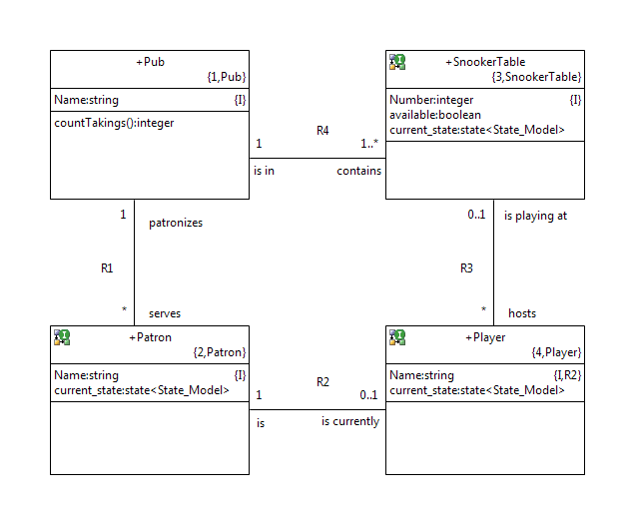
Preexisting Instances
Some instances exist before the system starts running.
Pub |  |  | Table
Name |  |  | Number | Available | State
The Kings Arms |  |  | 23456 | Yes | …
The Queens Head |  |  | 12345 | No | …
 |  |  | 67890 | No | …
 |  |  | 13579 | Yes | …

Slide 85
Workshop
Build associations between the classes you have so far.
Feel free to incorporate aspects of the provided solution.
Be sure to note:
name
multiplicity
conditionality
for each ‘end’, and the
association ID
for the association as a whole.
Remember to write association descriptions.
Apply the tests.

Slide 86
Association Classes
An association class is a class that comes about as a result of an association.
The association may have:
attributes that do not describe either participating class
behavior of its own
Licence
Owner
DogName
Date
Notes:
Association classes are used to contain attributes that hold data that isn’t properly part of either of the participating classes. An associative class is denoted by a dashed line drawn from another relationship line.
Instances of an association class come into existence when a relationship is created between the other two classes. Every pairing spawns one instance of an associative class. When the participating classes are unrelated, the association class is destroyed.
This type of class association is very common in communications.

Slide 87
Association Class
An association class is a class like any other.
But, an instance only makes sense in the context of a link.
Establishing a link for the association below relates one instance of each of the three classes.
Dog
owns
R1
1
Dog Owner
1..*
is
owned
by
Dog License

Slide 88
Finding Association Classes
Association classes come about when:
the association has data that describes it
the association has behavior of some sort
Licence
Owner
DogName
Date

Slide 89
Defining and Testing Association Classes
Define and test the ‘class’ bit as you would any class:
The Uniformity test
The OR test
The More-than-a-list test
The Table test
The –er test
Define and test the ‘association’ bit as part of the association descriptions.
The Multiplicity test
The Conditionality test

Slide 90
Generalization
Generalization partitions a set into subsets.
It is not the same as inheritance
Pet
Pet
Dog
Cat
Dog
Cat

Slide 91
5. Class Modeling
5

Slide 92
Class Modeling
Class modeling is rarely about the classes.
It’s easy to find:
tangible classes
classes derived from terms during clarification
components of various sorts
But they often hide behavior of other classes.
Consider this example:

Slide 93
A Phone Class
A Phone class could hide the behavior of :
the phone itself (on/off hook)
the making of a call
managing call-waiting
creating a conference call
etc
etc
etc
Better to split it up into multiple classes.
another example….

Slide 94
What are the classes?
Valve1
Valve3
Tank1
Tank3
Tank4
Tank2
Tank5
Tank6

Slide 95
Requirement: Move fluid from one tank to another
Find the valves that open a path from… … say, Tank 1 to Tank 4…
Tank1
Tank4
What are the classes?
How are they associated?

Slide 96
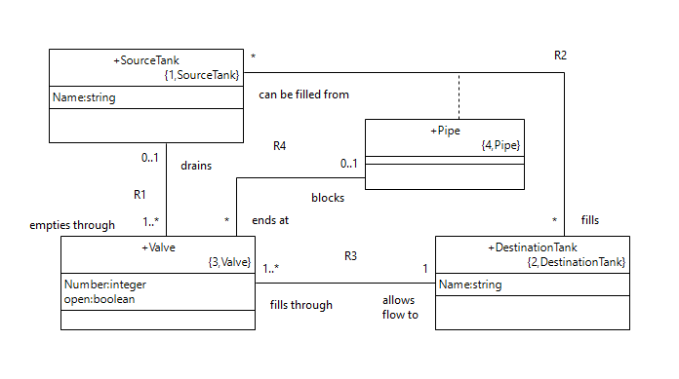
Obvious Classes: Tank, Pipe, Valve
Are we sure we are on the right track?
Is this a pipe?
Wait! Pipes must connect to each other… Let me think for a minute…

Slide 97
We could capture the configuration in code…
All valves control flow in or out of a tank. Most of the tanks are connected to one valve, but tank 4 has two. … we can special-case that in the code.
Valve4_1
Tank1
Special case for tank 4
Tank4
…
if ( start == “Tank1”) and ( tank . Name == "Tank_4" );
select any valve from instances of Valve
where ( selected . Name == “Valve4_1” );
valve . open = true;
end if;
...

Slide 98
Design change: a valve not connected to any tank!
Valve1
Valve3
Tank1
Tank3
Existing code does not handle that case.
Tank4
Tank2
Tank5
Tank7
Tank6

Slide 99
Abstractions
What are we interested in? – connectivity!
Does that mean we must model the tee-connections?
Do we care about pipes? – or just their connections?
Can we capture this connectivity at the class model level?
If so, the routing logic can be independent of configuration.
Tee

Slide 100
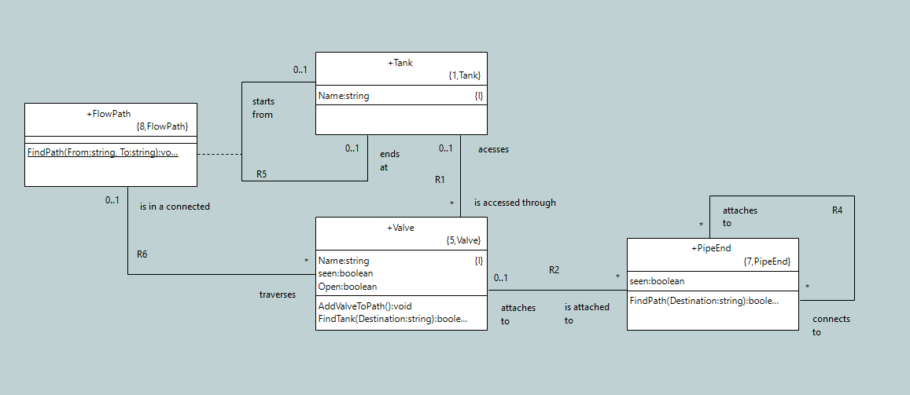
Class Model for Tanks and Valves
This simple class model represents many different configurations

Slide 101
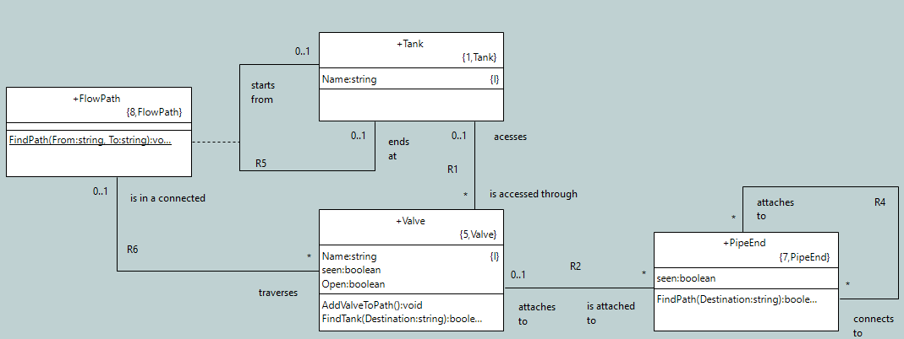
Connect Two Tanks…
Find all the valves on a path between two tanks and open them

Slide 102
Resilient to Change
Tank1
Tank2
…
Tank7
 | Valve1
 | Valve2
 | …
 | Valve7
 | Valve8
 | PipeEnd1
 | …
 | PipeEnd6
 | PipeEnd7
 | PipeEnd8A
 | PipeEnd8B
PipeEnd1
Add a new valve by editing configuration data.
No change to search algorithm.
Valve8

Slide 103
Adding Valve 8 by creating, relating instances
...
create object instance valve8 of Valve;
create object instance pipe_End8A of Pipe_End;
relate valve8A to pipeEnd8A across R2.'is attached to';
create object instance pipeEnd8B of Pipe_End;
relate valve8B to pipeEnd8B across R2.'is attached to’;
// connect tanks 6 and 7 to tank 1 via valve8
relate pipeEnd6 to pipeEnd8A across R4.'attaches to';
relate pipeEnd7 to pipeEnd8A across R4.'attaches to';
relate pipeEnd8B to pipeEnd1 across R4.'attaches to’;
...
Pipe end 1
Valve 8
Pipe end 6

Slide 104
What Did We Learn?
Putting behavior in the tangible classes makes them
large, and
hard to understand
And leads to complex state models with duplicated behavior.
Phone
* Number
* On/Off hook
* Dialing
* Number being dialed
* Call Waiting
* Conference call number
* etc

Slide 105
What Did We Learn?
To avoid that, we:
focus on associations
find the invariant
build classes that control dumb devices
Here’s another example:

Slide 106
Context
The motors in some pumps require a “gearing factor” depending on the desired final speed.
Type Pump Speed Gear Factor
Acme 101 0-10 1.0
10-25 1.75
25-50 2.0
NewPumpCo No gearing
Pump ‘em 0-20 1
20-80 3
Pump Speed = Motor Speed * Gear Factor

Slide 107
Changes
The number of tiers
The start and stop of each of the set points
The variety and number of devices.
Further idiosyncrasies of certain devices
Good approach?
Pump
Acme Pump
NewPumpCo
Pump ‘em

Slide 108
Invariants
There are tiers
Each tier is a line
No overlap between tiers
Pump ‘em
Gearing Ratio
3
Acme101
2
NewPumpCo
1
10
20
30
40
50
Desired Speed

Slide 109
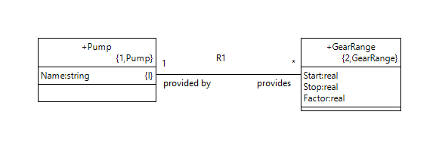
Abstractions
Pump
GearRange
Name
Acme 101
NewPumpCo
Pump’em
Start Stop Factor
0 10 1
10 25 1.75
25 50 2
0 20 1
20 80 3

Slide 110
The Behavior
Find the gearing factors provided by a pump type
Find the tier that contains the desired pump speed
Command motor speed = desired pump speed / gearing factor
Hmmm….wouldn’t tiers work for other devices?
Other computations?

Slide 111
Impact of Requirements Changes
Pump
GearRange
Name
Acme 101
NewPumpCo
Pump’em
NotherPump
Start Stop Factor
0 10 1
10 25 1.75
25 50 2
0 20 1
20 80 3
10 20 0.75
20 45 1.75
Only if the tier concept fails do we need more code ☺

Slide 112
Impact of Requirements Changes
Pump
Acme Pump
NewPumpCo
Pump ‘em
‘NotherPump
The impact is dependent on the abstractions you select.
More pump types mean more code ☹

Slide 113
Class Models
Class models capture:
abstractions of the things in and around the system
Ideally the invariants, the things and concepts inherent in the subject matter regardless of the current requirements
associations between the instances of these abstractions
rules about the instance population at any point in time
a single subject matter
a solution satisfying the requirements
not a comprehensive description
The granularity of reuse is the entire class diagram for a subject matter, not an individual class.

Slide 114
Good Class Models
Are easily understood by:
Experts in the subject matter so they can verify/dispute its correctness
Those new to the subject matter so they can learn the domain
Expose more information on the class diagram to lead to simpler state models and activities.
Expose information, not hide (“encapsulate”) it
The class diagram forms the basis for the domain. Investing in an accurate and precise model at this stage pays dividends later.

Slide 115
6. State Models
6

Slide 116
Executable Model Hierarchy
High level
Component Diagram
Decompose the application
Define Interfaces
Class Diagram
Abstractions
Operations
State Diagram
Lifecycle
Event handling
Low level

Slide 117
State Models
Some instances progress through stages during their lifetime.
The collection of stages and the order of progression constitutes its lifecycle.
It is represented as a state model, which may be captured as:
a state diagram
a state-event matrix
Open
 | Button pushed | Closed sensed | Arrival sensed | Open sensed
Open | Closing
Closing |  | Closed
Closed |  |  | Opening
Opening |  |  |  | Open
Open sensed
Button pushed
Opening
Closing
Arrival sensed
Closed sensed
Closed
Notes:
State machines handle the sequencing of the system over time.

Slide 118
State Models
A state diagram comprises:
States
Transitions
Events
Activities
We’ll talk about each in turn.
Open
Opening
Closing
Closed
Notes:
State machines handle the sequencing of the system over time.

Slide 119
States
A state is an abstraction of a stage in an instance’s lifecycle.
Open
Closed
Opening
Closing
WARNING: Many mathematical and object-oriented texts use “state” to mean the values of all the attributes.
Notes:
that xtUML does not use that definition.

Slide 120
Transitions
A transition is a change from one state to another (possibly the same) state.
Open
Closing
In Credit

Slide 121
Events
An event is an abstraction of a real-world incident that causes the instance to move from one state to another.
Open
Button pushed
Open sensed
Opening
Closing
Closed sensed
Arrival
sensed
Closed

Slide 122
Activities
An activity comprises a collection of actions that do something:
Create and delete instances
Read and write attributes
Create and delete links
Perform logic and arithmetic
Send events to other state machines
Open
Button pushed
activity
activity
Open sensed
activity
Opening
Closing
activity
Closed sensed
Closed
Arrival sensed
Activities may execute on a transition or on entry to a state

Slide 123
Finding States
Enumerate the states you know.
If necessary, write a description to describe the state further.
Open
Stuck
Closing
Idiot in Door
Closed

Slide 124
Blitz
A blitz is a technique for getting started.
There are no wrong answers.
We don’t categorize
We don’t organize
We don’t evaluate
We just enumerate
The purpose is to provide a starting point.
Notes:
Taken from http://www.maperformance.com/blitz-fatt-advance-boost-sensor-set-for-touch-brain-fatt-advance-plus-blz_19240.html
“Blitz Fatt Advance Boost Sensor Set for Touch Brain and Fatt Advance Plus”

Slide 125
State Blitz
Look at all the candidates and categorize them.
Definitely a state
Maybe a state
Definitely not a state
Open
Stuck
Closing
Idiot in Door
Closed

Slide 126
One State at a Time
An instance is in exactly one state at a time.
Choose states so that the instance is always in one state.
Open
Opening
Closing
Closed

Slide 127
Finding Transitions
For each state, examine all possible outgoing transitions and add the legal ones.
Remember to consider the reflexive transition for each state.
Open
Opening
Closing
Closed

Slide 128
Finding Patterns
Cyclic
Reusable resource such as equipment, link etc.
Usually settles in a state in which nothing is happening, named according to the subject matter
One shot
Manage an action with several phases, steps, stages
No record of action is required (Born and Die)
Record of action is required (Born and Quiescent)
Open
Accumulating
Opening
Closing
Complete
Cancelled
Closed

Slide 129
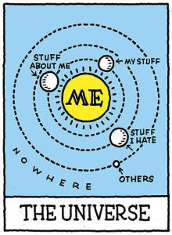
Anthropomorphize
Take the perspective of an instance:
How do I come into existence?
What happens to me to cause me to change state?
Where do I go from here?
Notes:
http://sarisl.wordpress.com/2013/07/28/egocentrism-is-not-the-same-as-narcissism/

Slide 130
Workshop
Find and name the states for the Pub system shown at the beginning of the section on classes.
Find and draw all the legal transitions.

Slide 131
Identify Events
For each transition…
…identify the triggering event
Check existing events
Define a new one if necessary
Make event names consistent in structure
Door opened = Open door = Door open =?????
Arrival sensed
Open
Button pushed
Open sensed
Opening
Closing
Closed sensed
Arrive
at floor
Closed

Slide 132

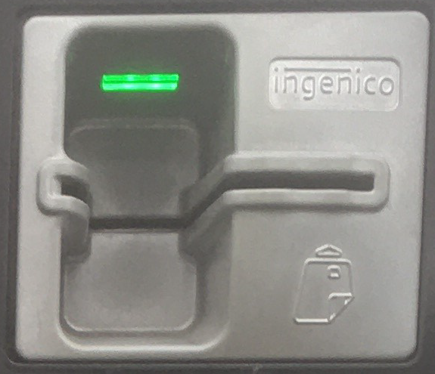
Event Parameters
Events may carry data with them
Each parameter has a name, a type, and a description
Parameter values are available to:
activity on triggered transition
entry activity for destination state
Examples follow…
ElevatorCall( Direction, Floor )
TicketInserted( TicketNumber )

Slide 133
Anti-Pattern
The state diagram should reflect a lifecycle, not a set of things to do.
Door opened
Button pushed
At rest
Arrive at floor
Door closed

Slide 134
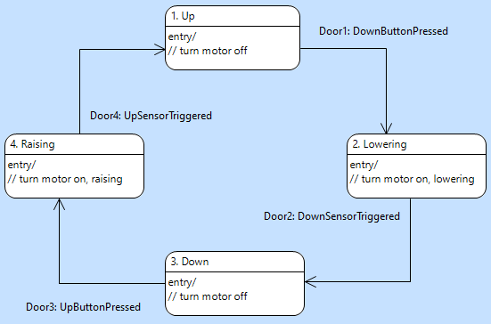
Garage Door State Model

Slide 135
State Models
The process for building state models:
Enumerate, name, and describe as necessary the states.
Define the legal transitions through exhaustive enumeration.
Define an event for each transition, reusing existing events as appropriate.
Use comments to describe activities.

Slide 136
Workshop
For each transition in the Pub system:
pick a name for the event that drives the transition
add it to the diagram
Don’t forget to check the list of existing events.

Slide 137
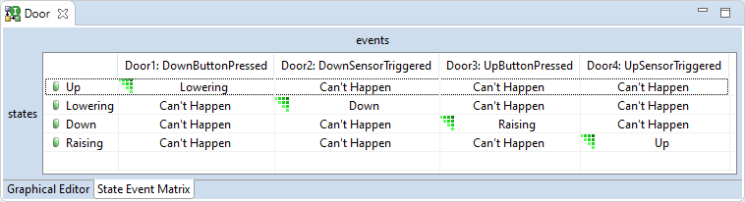
Checking for Completeness
A state-event matrix is used to check for completeness of a state diagram.
It has:
columns for events
rows for states
Each cell contains:
the name of the new state
links to the activities
Switch between state diagram and state-event matrix by selecting a tab on the state model editor

Slide 138
Interpreting a State-Event Matrix
Current state
Received event
Next state

Slide 139
Fill in the State-Event Matrix
The xtUML editor fills in the rest with “Can’t Happen”
Each cell containing a state name indicates a valid transition

Slide 140
Those “Can’t Happen” Cells
The cells filled with “Can’t Happen” by the tool can be:
A transition you forgot ➔
Go back to the state diagram and add the transition
An event that occurs, but you don’t care ➔
Change “Can’t Happen” to “Event Ignored” in the state-event matrix
A logical impossibility ➔
Something has gone horribly wrong (“Can’t Happen”)

Slide 141
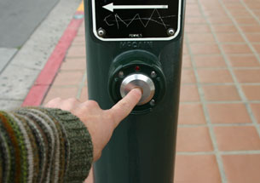
Event Ignored
An event can occur that you simply ignore.

Slide 142
Can’t Happen
An unexpected event can occur that likely indicates a:
a software fault
a hardware fault
You can’t do anything about it.
Use “Can’t Happen” for situations that cannot be recovered or handled by the application models.
If an undesirable event occurs, you have to handle it.
WARNING: “Can’t Happen” ≠ “Shouldn’t Happen”

Slide 143
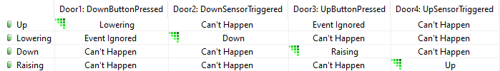
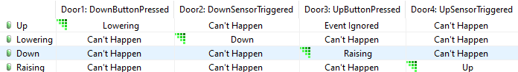
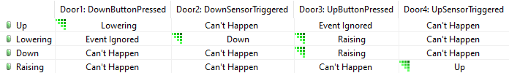
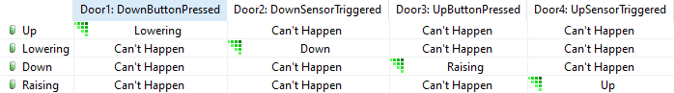
Filling the State Event Matrix
Examine each cell containing “Can’t Happen”
Decide whether it:
is actually a missing transition,
should be “Event Ignored”, or
should remain “Can’t Happen”

Slide 144
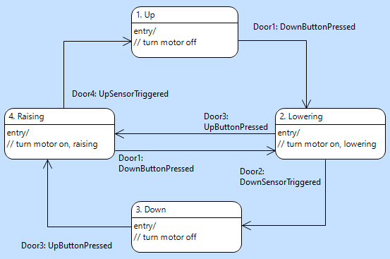
Completed Diagram
Missing transitions identified through examination of state-event matrix.

Slide 145
Workshop
Fill in the state-event matrix for a state model that you constructed.
For each cell (state x event), indicate whether it’s a:
transition to another (named) state,
event ignored, or
can’t happen

Slide 146
7. Activities
7

Slide 147
Executable Model Hierarchy
High level
Component Diagram
Decompose the application
Define Interfaces
Class Diagram
Abstractions
Operations
State Diagram
Lifecycle
Event handling
Activities
Processing
Low level

Slide 148
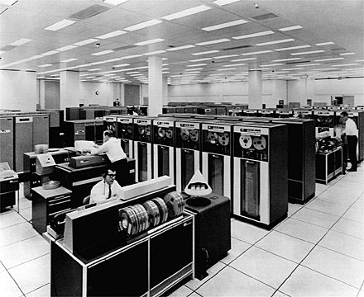
Activities
An activity is a block of model-level logic comprising a collection of actions that can:
Create and delete instances
Read and write attribute values
Compute new values
Generate events
Link and unlink associations between instances
Select instances across associations
Find instances based on attribute values
Communicate with the outside world
Notes:
http://blog.softlayer.com/2013/virtual-magic-the-cloud

Slide 149
Activities
You can place an activity in any of several locations.
In the context of a state model, that means
on a transition
on entry to a state
Open
Button pushed
activity
Open sensed
Opening
Closing
activity
Closed sensed
Closed
Arrival sensed

Slide 150
Activities on Transitions
You can associate an activity with a transition.
Open
Button pushed
activity
Closing
It executes when the transition is triggered and completes before any other activity is executed for this state machine.

Slide 151
Activities on Entry
You can associate an activity with entry to a state.
entry/
activity
1. Open
Button pushed
activity
An entry activity does not execute upon synchronous creation of an instance.
2. Closing
entry/
activity
An entry activity executes only on entry to the state, after the transition activity, if any, completes.

Slide 152
Event Data
Activities are handed parameters with the event.
ElevatorCall( Direction, Floor )
TicketInserted( TicketNumber )
When the activity terminates, only instance data remains.
You can think of an activity as a routine with input parameters and side-effects
only

Slide 153
Execution Sequence
An activity is executed on the transition
Another activity is executed on entry to the state
Both activities must complete before accepting another event
Both activities must complete before the instance may be considered to be in the next state
This is commonly called run-to-completion semantics
Open
Button pushed
activity
Closing
entry/
activity

Slide 154
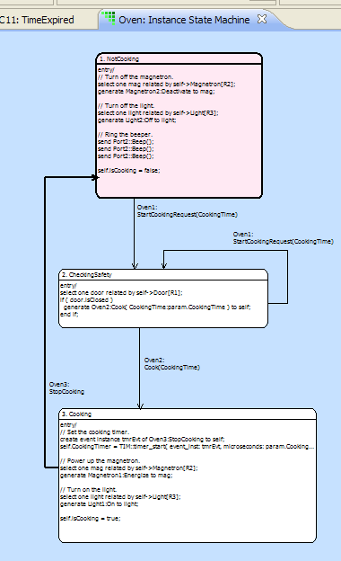
Event Dispatch
Event delivery causes one of:
Transition
Ignore
Can’t Happen
Transition:
Execute activity on transition
Execute activity within state
Change current state
Ignore:
Event is discarded, no state change, no actions
Can’t Happen:
System-level recovery invoked

Slide 155
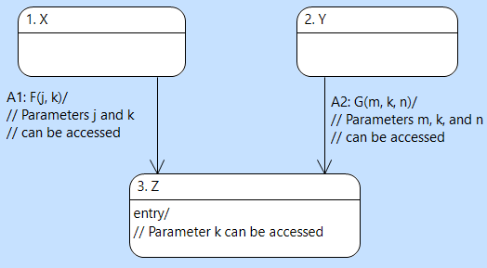
Relaxed Same-data Rule
Each transition activity has access to all parameters carried by the event that triggers it.
Each entry activity has access only to the parameters carried by all events triggering transitions into the state.

Slide 156
Activities Outside State Models
Activities can also be placed on the following model elements:
Operation of a class (class-based and instance-based)
Derived attribute of a class
Function
Port-message
Bridge operation
We will cover each of these in turn.
We specify each activity using an implementation-independent action language, enabling direct model execution as well as compilation into any target language.

Slide 157
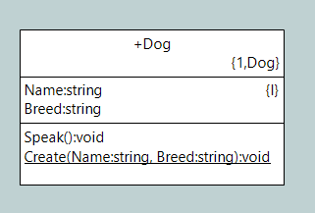
Operations
Instance-based operation
Invocation:
select any myDog from…;
myDog.Speak();
Class-based operation
Invocation:
Dog::Create();
Use operations to factor out common blocks of processing from state-models and port-message activities.

Slide 158
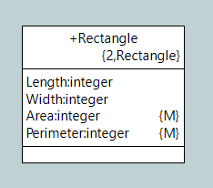
Derived Attribute
Derived attribute
Rectangle::Area:
self.Area = self.Length * self.Width;
Use a derived attribute instead of an instance-based operation when the quantity in question is an attribute of the class.

Slide 159
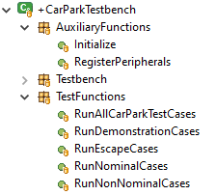
Function
Similar to a class-based operation, but global within a component.
Invocation:
::Initialize();
::RunNominalCases();
Use a function when the activity is:
Not associated with a class
Used as an initialization function for generated code

Slide 160
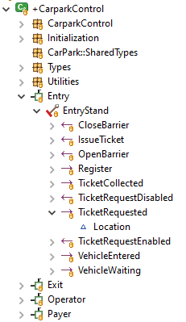
Port Message
Activity executes when an incoming message is received by a component through a port.
Use a port-message activity to handle incoming messages from outside the component (domain).
Keep them simple.
For example, find an appropriate instance using a parameter carried by the message and generate an event to it.

Slide 161
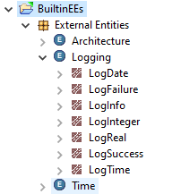
Bridge Operation
Represents an operation that is not part of the domain (subject matter).
Invocation:
LOG::LogInfo( message:”Hello, world!” );
Typically, bridge operations are used to connect to external code (e.g., Logging).
However, you can define your own external entity with bridge operations, and you can provide an activity expressed in action language for the bridge operation in addition to an implementation in external code.

Slide 162
Workshop
Construct a state model for each class in the GPS Watch that has a lifecycle.
Indicate the location of activities.
Describe each activity in natural language.

Slide 163
8. Action Language
8

Slide 164
Object Action Language [OAL]
Several action languages exist. This section focuses on OAL.
A reference manual for OAL is available online and within the Help facility of BridgePoint.
OAL is specific enough to be executable, but abstract enough that it does not prescribe implementation specifics.
create object instance request of Request;
select one channel related by device->Channel[R100.connects];
device.priority = lastpriority + 1;
generate Channel11:'host relinquish' to channel;
Notes:
Actions exist outside of the framework of a ‘main()’ function or routine, unlike conventional programming. Other purposes like file I/O, are left to the platform specific implementation of the model. xtUML is focused on the minimum set of specifications that form a functionally complete platform independent model.

Slide 165

OAL Does…
Object Action Language can:
Create and delete instances
Read and write attribute values
Compute new values
Generate events
Link and unlink associations between instances
Select instances across associations
Find instances based on attribute values
Communicate with the outside world
And control when these actions take place.
Notes:
https://levels.io/100-to-0-things/servers-server-farm-engine-room/

Slide 166
Data Types
Core primitive data types
Boolean
integer
real
string
unique_id
Reference data types
instance handle
instance handle set
event instance
component instance handle
All data items are implicitly typed by the value assigned to them on their first use within an action.
Built-in user-defined types
date
timestamp
timer handle
Notes:
Rich datatypes allow flexibility in modeling.

Slide 167
Operators
In addition to the usual operators:
empty [<instance handle> | <instance handle set>]
not_empty [<instance handle> | <instance handle set>]
cardinality [<instance handle> | <instance handle set>]
Notes:
Comprehensive operator support.

Slide 168
Loops
Use for each to iterate over a collection.
A general-purpose while loop is also provided.
for each mobile in mobiles
// do something
end for;
i = 0;
while (i < 4)
// do something
i = i + 1;
end while;
Notes:
No FOR loop available, only FOR EACH. Use the WHILE loop to implement, as is done in the example.

Slide 169
Parameters
Parameters are sent by:
Sending an event or interface message
Invoking a function or operation
Activities access received parameters using param
param is a pre-pended keyword
Parameters are tagged, not positional
select any probe from instances of SP where
selected.probe_ID == param.probe_id;
trackPoint.latitude = param.latitude;
bot.speak( message:”Hello, how may I help?” );

Slide 170
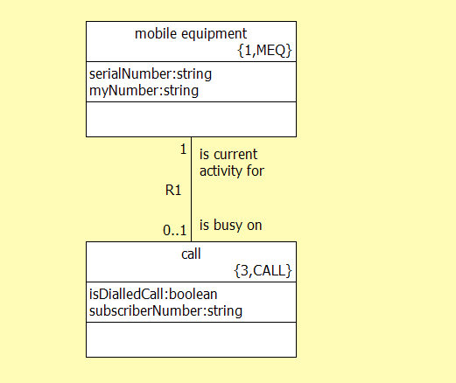
Relate / Unrelate Statement
Link specific instances of classes using relate.
relate mobile to call across R1.’is busy on’;
Local instance reference variable
Association ID
Association phrase
unrelate mobile from call across R1.’is busy on’;
Local instance reference variable
Notes:
Relationships are not instantiated as soon as the two involved classes are instantiated, they must be created using the ‘relate’ statement.
These relationships are a fundamental part of the model specification; can be used for selecting particular instances of classes.

Slide 171
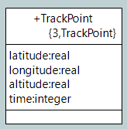
Select Any / Many
select any point from instances of TrackPoint;
Resulting instance reference
Key letters
select many highPoints from instances of TrackPoint
where selected.altitude > 10000;
Where clause

Slide 172
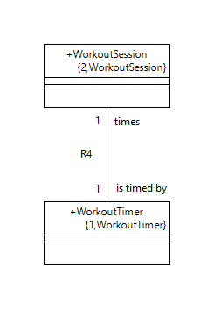
Select One / Many … Related By
select one requires use of the related by clause
self is the instance for which the activity was invoked
Resulting instance reference
Starting instance reference
select one timer related by self->
WorkoutTimer[R4.is timed by’];
Key letters
Association ID
Association phrase
Notes:
The ‘select one/many … related by …’ statement is useful for selecting an instance of a class (or instances) that is related to a specific instance of the other participating class. The arrow points to the target class; in this example “call”.
The ‘select one’ construct is used when the target class (call) has a multiplicity of 1 or 0..1. Use the ‘select many’ construct when the multiplicity of the target class is 0..* or 1..*.
The ‘select one/many … related by …’ statement is useful for selecting an instance of a class (or instances) that is related to a specific instance of the other participating class. The arrow points to the target class; in this example “call”.

Slide 173
Workshop
Write OAL for the activity that completes the goal, specifically:
Move the just-completed goal from ‘Currently executing’ (R11) to ‘Executed’ (R12)
Create a new goal based on the next one in sequence
Associate the newly created goal with the currently executing goal

Slide 174
9. Distribution of Intelligence
9

Slide 175
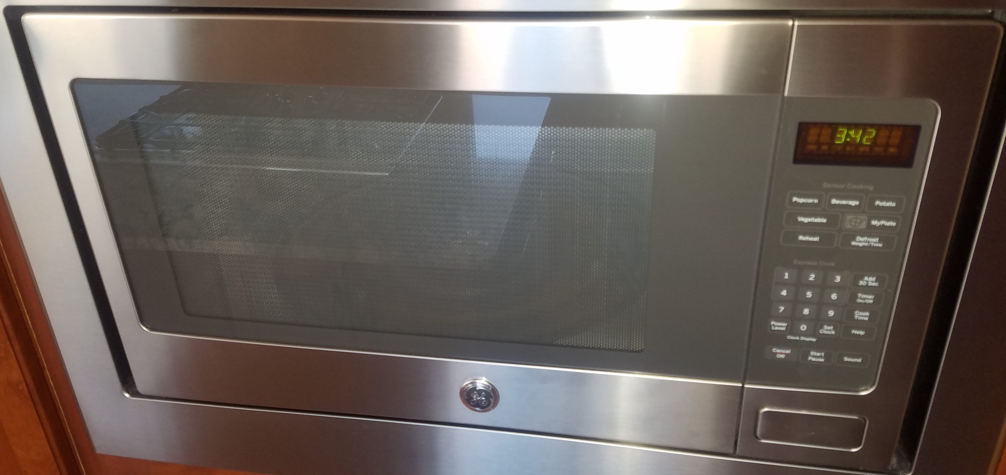
Tangible Things
Placing too much intelligence in a tangible class often results in a complex, brittle state model.
It is better to drive tangible
classes with more abstract
classes.
You must distribute
intelligence among the classes to produce simple, flexible,
data-driven models.
Often, tangible classes turn out to have
simple, uninteresting lifecycles.

Slide 176
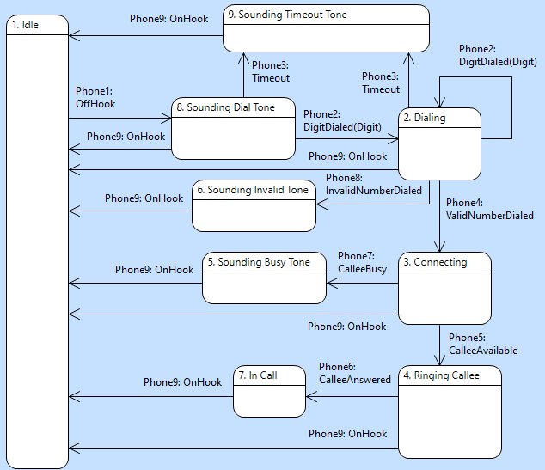
Complex State Model

Slide 177
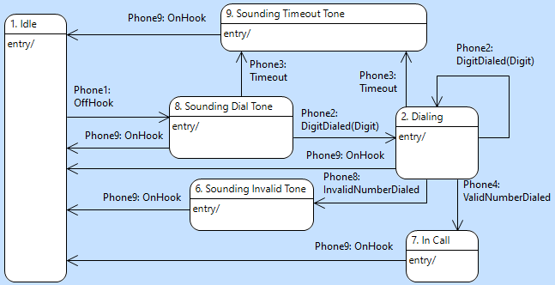
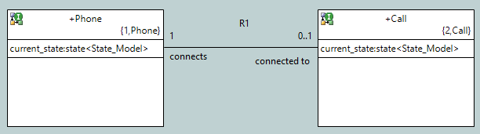
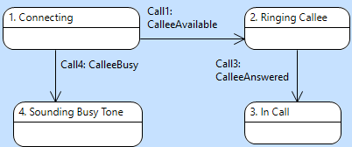
Simpler Communicating State Models
Phone
Create instance of Call
Call

Slide 178
Patterns
There are two control patterns that occur frequently:
Top-driven: where a user/operator drives behavior
Bottom-driven: where a device/hardware drives behavior
And two aspects of data flow:
Push-and-pull: Data is pushed in, and pulled out
Pivot: The pivot is the place where the data comes “to rest”

Slide 179
Top-Driven
In a top-driven pattern, a user/operator drives behavior.
Examples:
Microwave oven
Chemical plant operations
Phone calls
Cook
Start
Oven
StartStep
FinishStep
Cooking Step
TurnON
TurnOff
Magnetron

Slide 180
Bottom-Driven
In a bottom-driven pattern, a device/hardware drives behavior.
Examples:
Meter Reading
Alarm System
Satellite
Bill
PrintBill
EndOfMonth
Account
ReadingVerified
Reading
ReadingTaken
Meter

Slide 181
Push-and-Pull
In push-and-pull, data is
pushed so far, then
rests, then is
pulled the rest of the way
Examples:
Meter Reading
Order fulfillment
Message accumulation
Bill
PrintBill
EndOfMonth
Account
ReadingVerified
Reading
ReadingTaken
Meter

Slide 182
Pivot
The trick with push-and-pull is to find the pivot.
Reading
1..*
1
Account
1..*
1
Readings are “pushed” to the Account when read, then “pulled” by the Bill when it’s time.
Bill

Slide 183
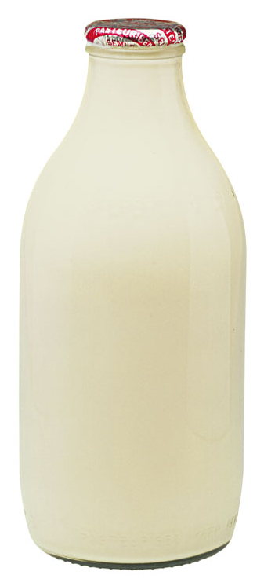
Associations
Associations often carry interesting behavior.
Does the cow demilk itself? Or the milk uncow itself? Neither!
Milking
MaxDuration
ActualDuration
Volume

Slide 184
Anti-pattern
Avoid controller/manager state models that control everything.

Slide 185
Workshop
Based on what you just learned, review and revise your state models to improve the distribution of intelligence.
Be prepared to describe your approach for distribution intelligence to the class.

Slide 186
10. Model Execution
10
Notes:
Added new section, as discussed

Slide 187
State Machines
A state machine is an instance-specific execution context with states and transitions specified by a state model.
Each state machine has its own current state.
Cooking Step 1
Ready
startStep
interrupt
Executing
Oven
finishStep
finishStep
Complete
Not Cooking
close door
Cooking Step 2
start
Ready
Checking
cook
finish_step
startStep
interrupt
stop
Executing
Cooking
finishStep
finishStep
Complete

Slide 188
State Machines
Each class has a state model.
Each instance has a state machine.
Cooking Step 1
Ready
startStep
interrupt
Executing
Oven
finishStep
finishStep
Complete
Not Cooking
close door
Cooking Step 2
start
Ready
Checking
cook
finish_step
startStep
interrupt
stop
Executing
Cooking
finishStep
finishStep
Complete

Slide 189
Concurrent Execution
All instances execute concurrently.
Oven
Not Cooking
close door
Cooking Step 1
start
Checking
Ready
cook
finish_step
startStep
interrupt
stop
Cooking Step 2
Cooking
Executing
finishStep
finishStep
Ready
Complete
startStep
interrupt
Executing
finishStep
finishStep
Complete

Slide 190
Executing the Model
Transitions are triggered by events sent from:
Other instances
This instance
Timers (delayed events)
Port-message activities handling incoming messages from other components, hardware, etc.
Ready
startStep
interrupt
Executing
finishStep
finishStep
Complete

Slide 191
Communication
State machines drive each other through their lifecycles by sending each other events.
Events are reliable
Events do not interrupt executing activities
Activities run-to-completion
Oven
Cooking Step 1
Ready
Not Cooking
start
start
startStep
interrupt
Executing
Checking
finishStep
stop
cook
finish_step
finishStep
Complete
Cooking

Slide 192
Run-to-Completion ≠ Atomic!
State machines (and their activities) run concurrently
An activity can be pre-empted during execution
One activity may change data accessed by another
Instance Data
Activity B
Activity A
Modify
Read
Which one happens first?
Synchronization of state machines is accomplished with events
If it is important that Activity A executes before Activity B,
…the state models involved must use events to ensure it.

Slide 193
Event Ordering
B2
5
2
B4
Events sent from one instance to multiple instances are received in an indeterminate order.
C3
C1
4
Events sent from one instance to another are received in the order they are generated.
xtUML rules of execution specify only that:
Instance 5 receives B4 after it receives B2.
Scenario:
Instance 2 sends C1 to instance 4
Instance 2 sends B2 to instance 5
Instance 5 sends C3 to instance 4
Instance 2 sends B4 to instance 5

Slide 194


Time and Timers
The current time can be read, stored, and used in computations
It is an integer representing a duration beyond a defined epoch
Values can be compared (x<=y)…
…and computed (x+5)
A timer can generate an event after a delay (e.g., 10 seconds)
The delay specified is a minimum
You may cancel a timer
But the event may already be “in flight”
You must account for that case

Slide 195
Summary
Build models relying only on the execution rules of xtUML
Use a model compiler that implements these rules for your target
Understand the trade-off between model portability and exploitation of platform-specific characteristics
Make deliberate, explicit decisions and document them clearly

Slide 196
Workshop
Get Pub state machines from your instructors.
Label instances of Patron, “Hugo”, “Debbie”, “Tiny”, “Zoltan”.
Place coins on the initial states of each state machine:
Patron Hugo: Outside
Patron Debbie: Drinking
Patron Tiny: Drinking
Patron Zoltan: Needs Drink
Snooker Table 1: Available
and walk through their lifecycles as shown on the next page.

Slide 197
Workshop
Inject the following events and change states appropriately:
Patron 1: Thirsty to Patron Tiny
Patron 1: Thirsty to Patron Hugo
Patron 2: Served to Patron Zoltan
Patron 3: Bored to Patron Zoltan
Patron 2: Served to Patron Tiny
Player 1: Look for Table to Player Zoltan
Patron 2: Served to Patron Hugo
Patron 3: Bored to Patron Debbie
Patron 1: Thirsty to Patron Tiny
Player 1: Look for Table to Patron Debbie
Player 2: Found Table to Patron Zoltan
Player 2: Found Table to Patron Debbie
Patron 2: Served to Patron Tiny
Patron 1: Thirsty to Patron Tiny
Patron 2: Served to Patron Tiny
SnookerTable2:LastBallPlayed to Table 1
Patron 1: Thirsty to Patron Zoltan
Patron 5: Sated to Patron Debbie
Patron 1: Thirsty to Patron Tiny
and walk through their lifecycles.
Notes:
Everyone is in the pub except Hugo, and everyone is drinking except Zoltan. Check Player/Patron

Slide 198
Workshop
Expected Post-conditions:
Patron Hugo: Drinking
Patron Debbie: Outside
Patron Tiny: NeedsDrink
Patron Zoltan: NeedsDrink
Snooker Table 1: Available

Slide 199
11. Components and Interfaces
11
Notes:
Added new section, as discussed

Slide 200
Executable Model Hierarchy
High level
Component Diagram
Decompose the application
Define Interfaces
Class Diagram
Abstractions
Operations
State Diagram
Lifecycle
Event handling
Activities
Processing
Low level

Slide 201
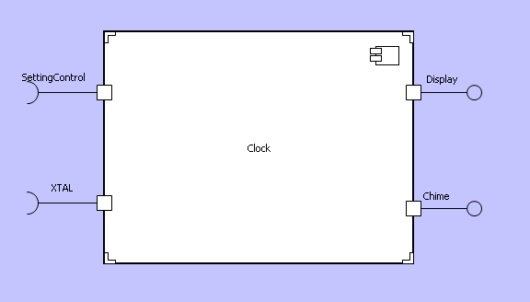
Components
A component is a part of a system that hides its implementation behind ports.
The inside of a component can “see” the outside only through its ports.
Components and ports are named.
Component
Port
Notes:
Components are similar to “black boxes” in system design. Their function is not visible from outside, and they must have a well defined set of interfaces at the boundary to facilitate cooperation with other components. There is no way of ‘seeing inside’ the component to access its individual model elements, all communication must be handled through those defined interfaces.
Being a “black box”, components that have the same interfaces at the boundary can be substituted for each other. This is called the “interface signature”.

Slide 202
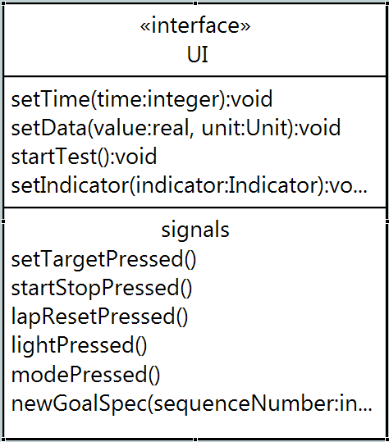
Interfaces
An interface defines of collection of messages, similar to a declaration in a programming language.
Two types of messages:
Synchronous operations may:
return values
accept reference parameters
Asynchronous signals
Each interface is defined and
maintained in a single place, and may be used by many ports.
Each message can carry typed parameters.

Slide 203
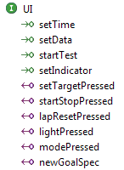
Messages
Messages have a direction
(relative to/from the provider).
The ball indicates the provider.
The arrow indicates the direction of the message in an interface definition.

Slide 204
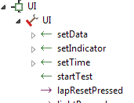
Ports
Each port …
… surfaces one specific interface …
… by referencing an interface definition.
Messages, carrying parameters, may flow into and out of a port.
Port name
Interface Definition
{
Messages

Slide 205




Naming Ports
Name each port from the perspective of the component sprouting the port

Slide 206

Port Activity
Each message may have a port activity executed when the message is received.
It may contain any actions valid within the context of the receiving component. Best to keep port activities simple:
invoke an operation
generate an event to an instance

Slide 207

Provided vs. Required Interfaces
The distinction between provided and required interfaces in xtUML is arbitrary.
Along with the graphical notation, it provides a point of reference for message direction (to/from provider).
Do not expend much effort deciding whether a component should provide or require an interface.
Provided
Required

Slide 208
Workshop
Draw the Component Diagram for this system.
Define all the interfaces.
Write at least one port activity.

Slide 209

Bridges
A bridge operation:
Is declared within an external entity
May accept parameters; may return a value
Can be wired to external code or defined with OAL
It is used for library functions
Time
Logging
Math
And for scaffolding
OAL or Java for Verifier
Hand-written code for target

Slide 210

Ports vs Bridges
Favor Components and ports except…
When surfacing connections between elements is unnecessary or unhelpful

Slide 211
12. Model-Driven Testing
12

Slide 212

Model-Driven Testing
Model-driven testing is the notion that you can use models to build tests.
Test case

Slide 213
Types of Testing
There are two types of tests. Those that
are coupled only to the interface
include knowledge of the models
owned by the Q&A (and anyone focused on the what not the how)
owned by the modelers

Slide 214
Black-Box Testing
Black-box testing tests the system from the outside.
Black-box testing knows only:
what the actor wants from the system
the interface
It treats the system as a “black box”.
Test case
Provided
Models Under Test
Required

Slide 215

White-Box Testing
White-box testing tests the system from the inside.
Advantages of white-box tests include:
Increased visibility and access, enabling
finer-grained, more detailed testing
Often simpler to build
Test case
Provided
Required
Notes:
Typo: “White-box testing is all…”

Slide 216

White-Box Tests
White-box testing is all about the models. They can:
Create and delete instances
Access attributes and association links
Anything you can do to a model
Test case
Provided
Required

Slide 217
Use Cases
A use case says how a role uses a system to meet some goal.
Therefore, the use case becomes the basis for building tests.
Testing requires:
Preconditions
Stimulus
(Expected) Postconditions
(Actual) Postconditions
A determination
You have these from the use cases.
(Except for the last two!)

Slide 218
Testbench
A testbench supplies:
The test execution framework
Models of things outside the system
Models of pieces of the system that are not yet available
The test suite
Test Bench
We must model what is around the system.

Slide 219
Testing Structure
Soooooo, create a:
Test bench component with appropriate interfaces, then
Connect it to the components under test
Test Bench
Provided
Models Under Test
Required

Slide 220
Use a Model
Use action language functions to establish preconditions, inject the initial stimulus and verify postconditions.
When necessary, use state models to
inject additional stimuli,
receive responses from models under test,
Detect completion
Setup
create object instance FredsPlace of Pub;
FredsPlace.Name = "FredsPlace";
create object instance table of SnookerTable;
table.Number = 37;
table.available = true;
relate FredsPlace to table across R4.contains;
create object instance Tiny of Patron;
Tiny.Name = "Tiny";
…..

Slide 221
Workshop
Build a modeled test case, covering UC01 for the GPS Watch.

Slide 222
13. What’s Next?
13
Notes:
Added new section, as discussed

Slide 223
Executable Model Hierarchy
High level
Component Diagram
Decompose the application
Define Interfaces
Class Diagram
Abstractions
Operations
State Diagram
Lifecycle
Event handling
Activities
Processing
Low level

Slide 224
What’s Next?
Motivational Discussion
Tool Introduction
Requirements Clarification
Basic xtUML Modeling
Tool Training
Completion of Case Study Model
Team Modeling Exercise
Advanced xtUML Modeling
You are here

Slide 225
Workshops
How to be most effective in workshops?
Bridgepoint?
No. Focus is on modeling.
Post-it notes?
Yes. Easy to move around, delete, rewrite
Use them for classes, states, components
Flipcharts?
Yes. Good for collaboration.
Use for model canvas; post-it notes + drawn lines
Phone cameras?
Useful for capturing prior versions

